Slide 1
PERFORMANCE EVALUATION AND DETECTION OF MALWARE
A
Project Presentation
on
By
Under the guidance of
Mr. ASHWINI KUMAR VERMA
Assistant Professor , Dept. of CSE
Greater Noida Institute of Technology

Slide 2
Outline of Presentation
Introduction
Objective
Problem Statement
Proposed System
Methodology
Result
Conclusion
Future Scope

Slide 3
Introduction
Malware is a general term for any type of malicious software.
It's a file or code that's installed on a computer without the user's permission.
Malware can steal passwords or money, encrypting or deleting data or spying on computer activity.
Malware can be classified as 1st and 2nd generation of malware.

Slide 4
Introduction
1st Generation Malware produces malicious behaviour on the target systems without changing its structure which includes virus, spyware , trojan, etc.
For the investigation of these Malwares, different static characteristics such as 'hash value', 'N-grams', 'opcodes', 'strings', and 'PE header' information are retrieved from the malwares' code.
Second Generation Malware analysis is a technique, where malware files are executed and the behaviour of malware is observed.

Slide 5
Objective
The Main objective is to find the best accuracy of the the malware detection using different machine learning models .
Machine learning techniques includes such as Random forest, XGBoost,Decision Tree and many others.

Slide 6
Problem Statement
Existing Antivirus company are utilizing the Signature based detection system.
Malware detection are based on static analysis and dynamic analysis.
In static analysis hash code of the malware generated.
In dynamic analysis the PE file executed using debugger after the execution, we can verdict the file is malware or not.
Most of the researcher utilizing the machine learning based malware detection system using the algorithms like Linear Regression, KNN, SVM and Naïve Bayes.

Slide 7
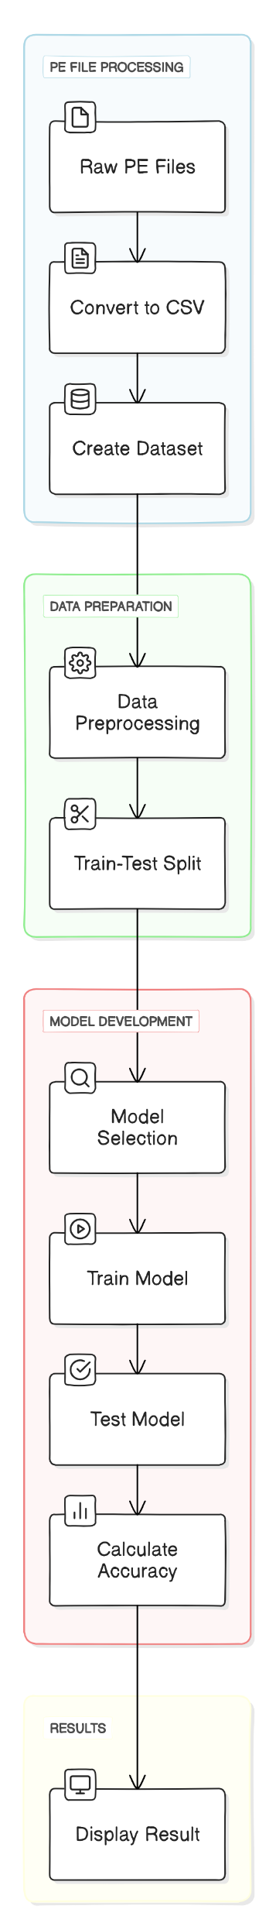
Proposed System
Malware is changing rapidly and is unable to detect.
Earlier the methods used to detect malware was signature based but due to advancement in malware it is unable to detect
We use machine learning model such as XGBoost, Decision Tree, Random Forest,etc. to evaluate the accuracy on the given dataset.

Slide 8
Methodology
PE Files
PE stands for Portable Executable. PE files are a file format for executables and other binary file types used in Windows operating systems.
They are based on the COFF file format (Common Object File Format).
PE files include:
Executables (.exe)
Dynamic link libraries (.dll)
Kernel modules (.srv)

Slide 9
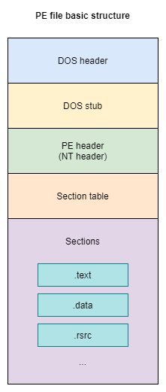
Methodology
Structure of PE Files

Slide 10
Methodology
We converted the PE files to CSV Files.
We got total 58 features CSV File.
Conversion of PE files to CSV file

Slide 11
Methodology
Now, data preprocessing is done, including removing unnecessary features, handling outliers, and managing the imbalanced dataset.
Removal of unnecessary Features

Slide 12
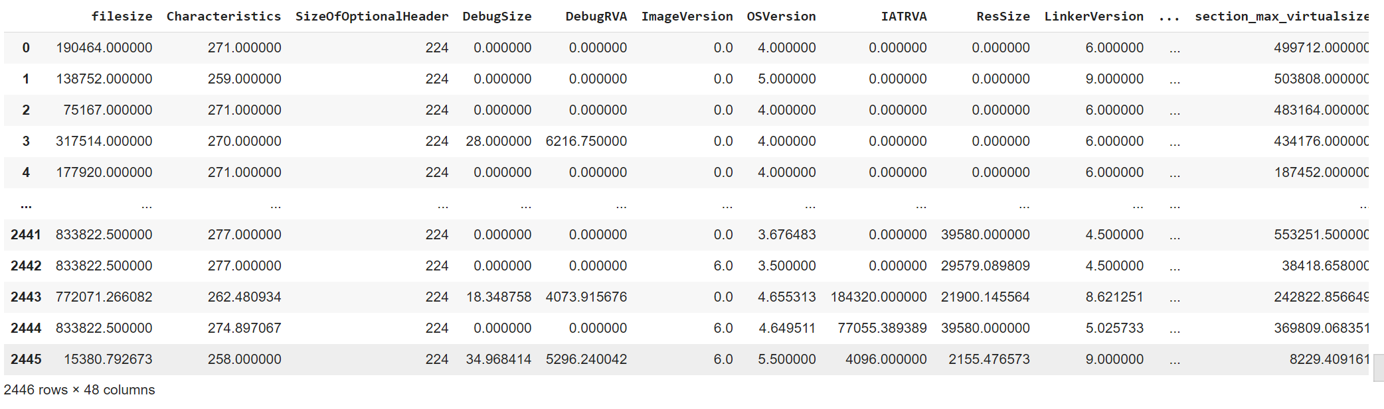
Methodology
Balanced Dataset

Slide 13
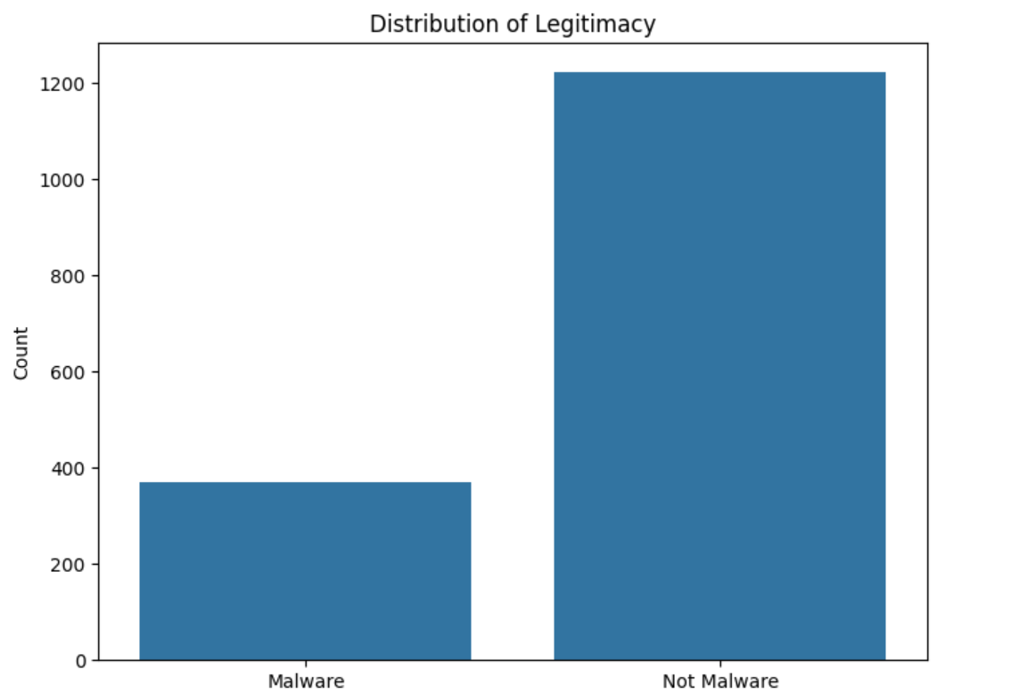
Methodology
Dataset Distribution

Slide 14
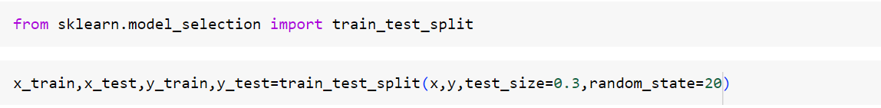
Methodology
Now, the train-test split is done in a 70:30 ratio.
Train-Test Split Operation

Slide 15
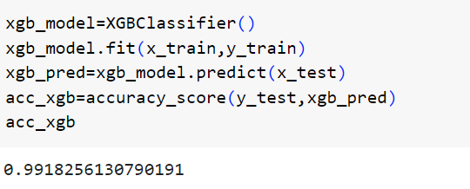
Methodology
XGBoost Algorithm
XGBoost stands for "Extreme Gradient Boosting“
Outperforms other boosting algorithms in terms of speed, accuracy and flexibility.
XGBoost can be used for both classification and regression tasks
Accuracy of XGBoost

Slide 16
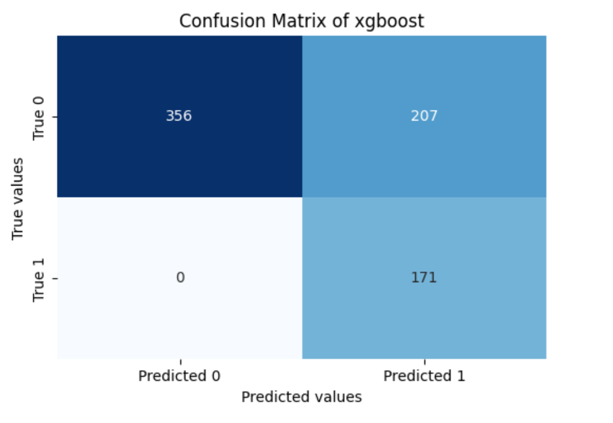
Methodology

Slide 17
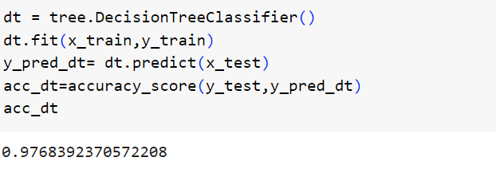
Methodology
Decision Tree Algorithm
Decision Tree can be used for both classification and regression tasks
Builds a tree-like model of decisions and their possible consequences.
The algorithm selects the best feature and split point that maximizes information gain or minimizes impurity (e.g., Gini impurity, entropy).
Accuracy of Decision Tree

Slide 18
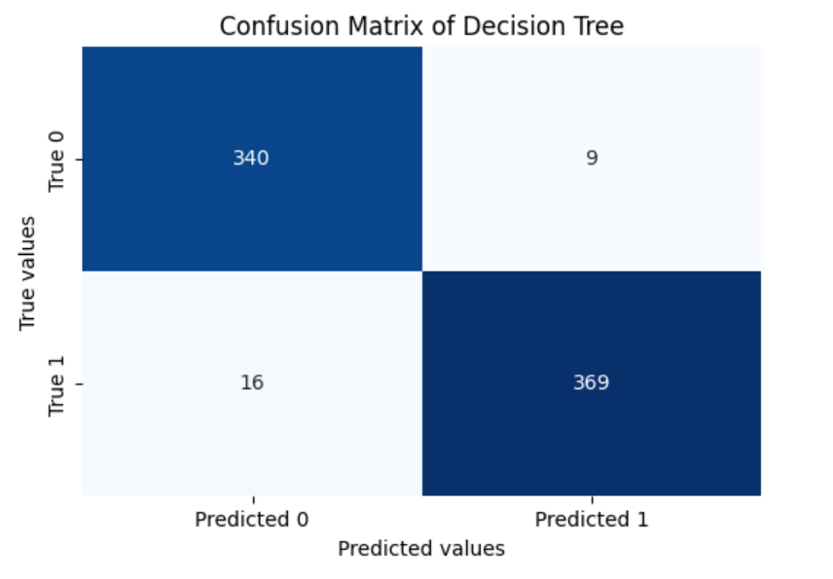
Methodology

Slide 19
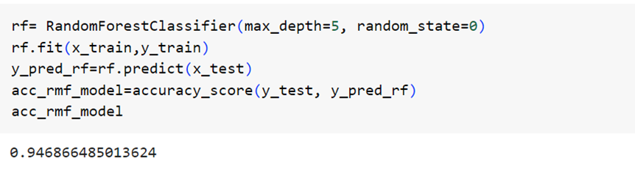
Methodology
Random Forest Algorithm
Random Forest are combination of multiple decision trees.
Each tree is built using a random subset of features and training instances.
Random Forest can be used for both classification and regression tasks.
Accuracy of Random Forest

Slide 20
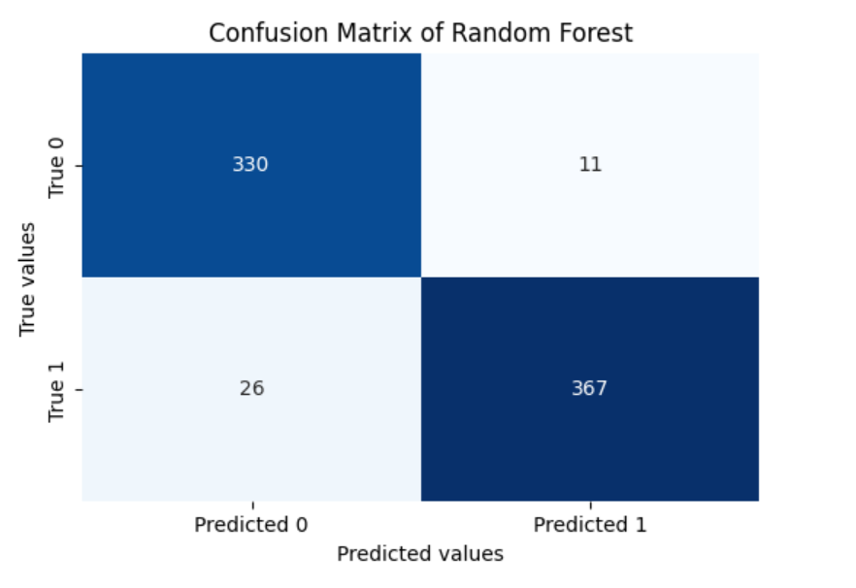
Methodology

Slide 21
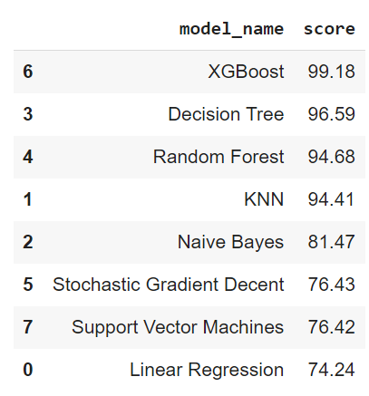
Results
Different Machine learning algorithm applied and their Accuracy

Slide 22
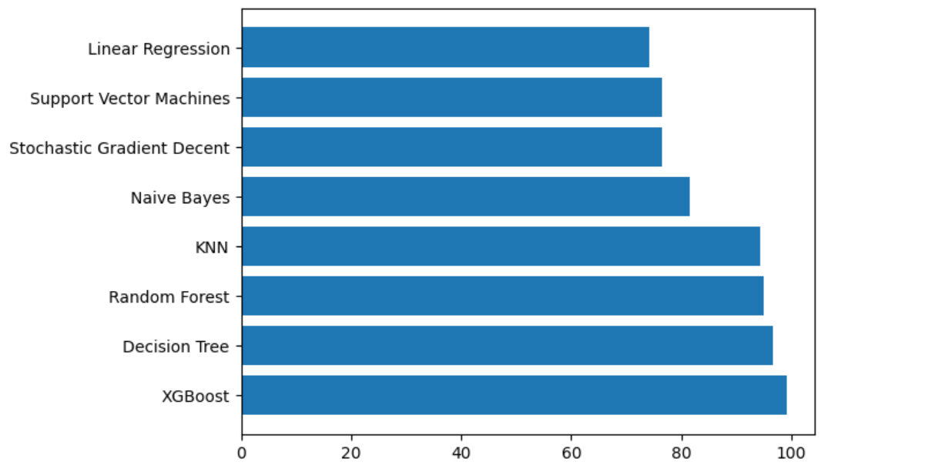
Results
Graph of Different ML techniques and their Accuracy

Slide 23
Conclusion
Different Machine learning Techniques that have been used to find the accuracy.
XGBoost, Decision Tree and Random Forest have the highest accuracy among other machine learning techniques.

Slide 24
Future Scope
Focus on making the interface of the model where we can upload the file and find the accuracy using our top 3 machine learning model.
Explore the use of advanced machine learning models, such as deep learning and neural networks, for more accurate and adaptive malware detection.

Slide 25
Thank you

